Slide 1

U.S. Real Estate?
Explore 3 years (2023,2024,2025) of U.S. real estate in Chicago, Houston, Los Angeles , Miami , New York ,its challenges, and strategic future actions. This presentation highlights critical market insights paired with a sleek gold and black theme for a premium feel.

Slide 2
Agenda
1
Introduction
2
Technical Steps
3
Insights Gained
Project overview and objectives.
How we built the solution (Azure Database to Dashboard).
Key findings from the data.
4
Recommendations
5
Conclusion
Actions based on the insights.
Summary and next steps.

Slide 3

Technical Steps
Creating an Azure SQL Database
Action: Provisioned an Azure SQL Database to host real estate data.
Why Azure?: Scalability, security, and integration with Power BI.
Importing Data
Action: Imported datasets (properties, visits, sales, agents, etc.) into the SQL database.

Slide 4

Introduction
Objective
Improve understanding of real estate performance.
Leverage data to support business decisions.
Scope
Track property sales, visits, and performance metrics.

Slide 5
Tools We Use :
- Microsoft Azure ➔Secure cloud storage and scalable analytics.
- SQL ➔ SQL Server
- Python & Machine Learning ➔Pandas , Plotly , Seaborn ,Matplotlib , scikit learn
- Power BI ➔ Visualize insights for decision-making.
Key Metrics We Track:
🏠 Property Analytics: Market trends, pricing, and inventory.
📈 Sales Performance: Deals closed, revenue, and growth.
👥 Agent & Client Engagement: Agent productivity and client interactions.
📍 Location-Based Insights: Neighborhood demand and investment hotspots.

Slide 6
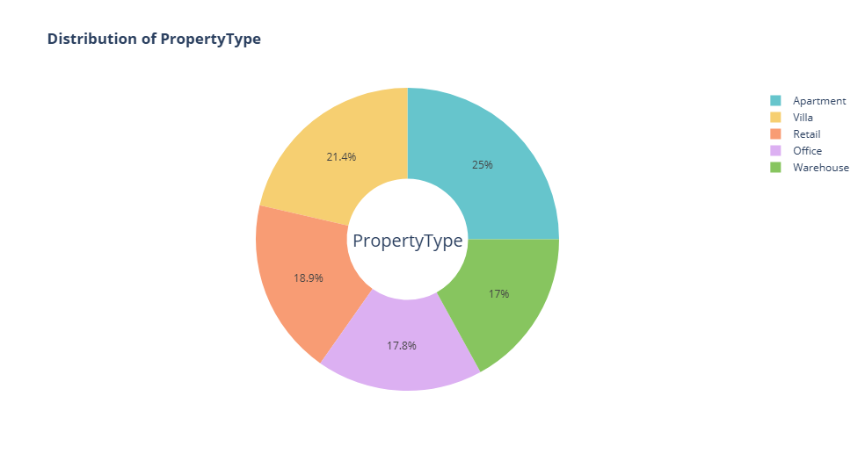
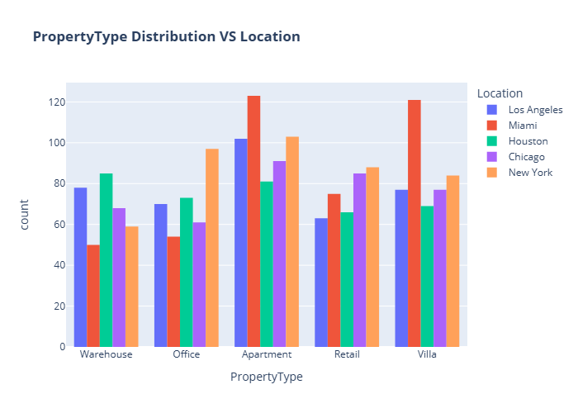
🏠 Property Analytics

Slide 7
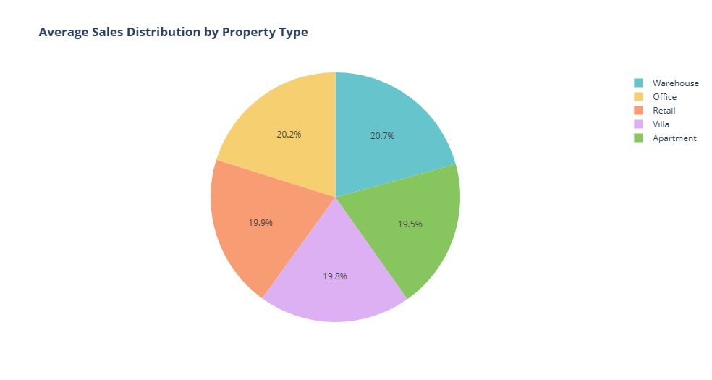
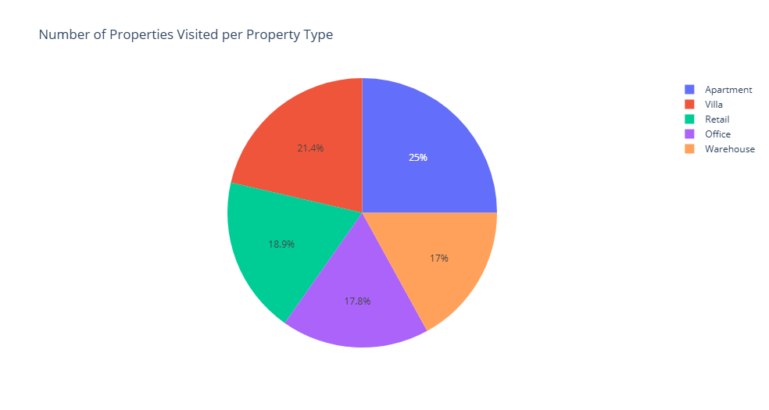

Slide 8
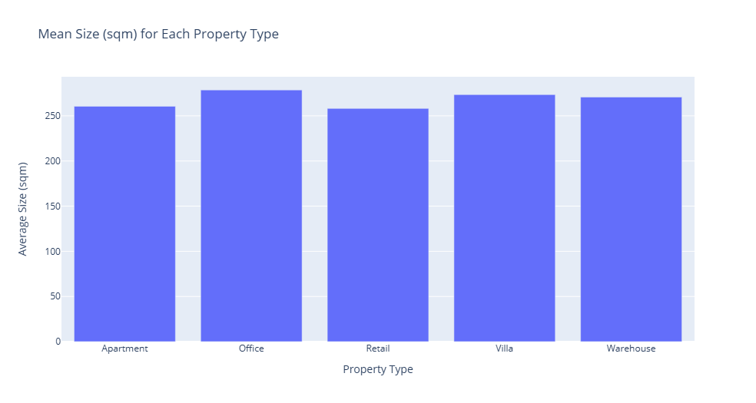
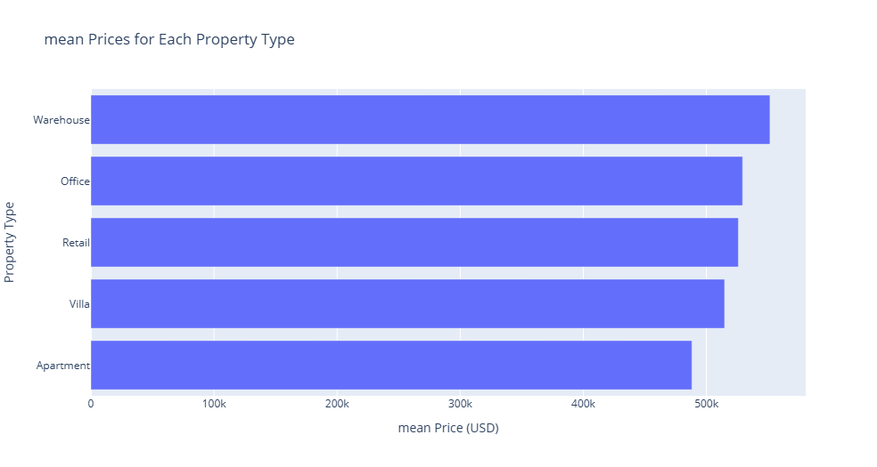

Slide 9
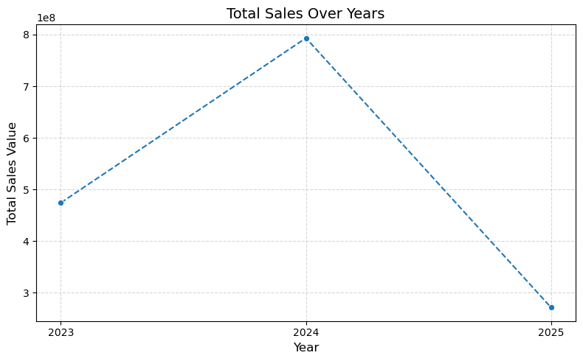
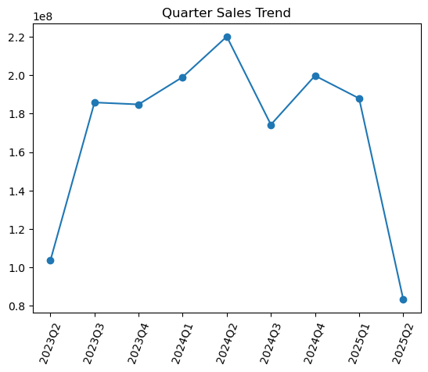
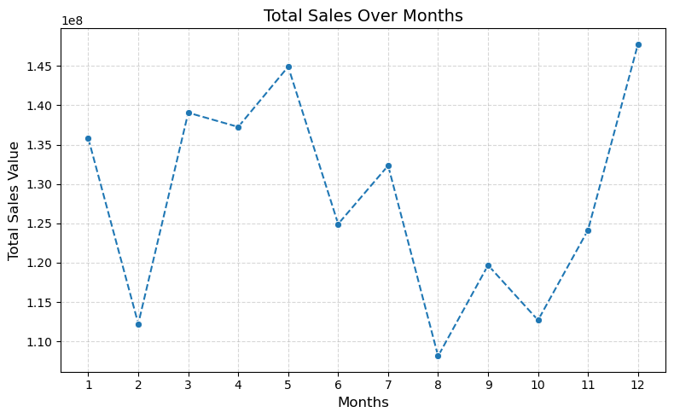
📈 Sales Performance

Slide 10
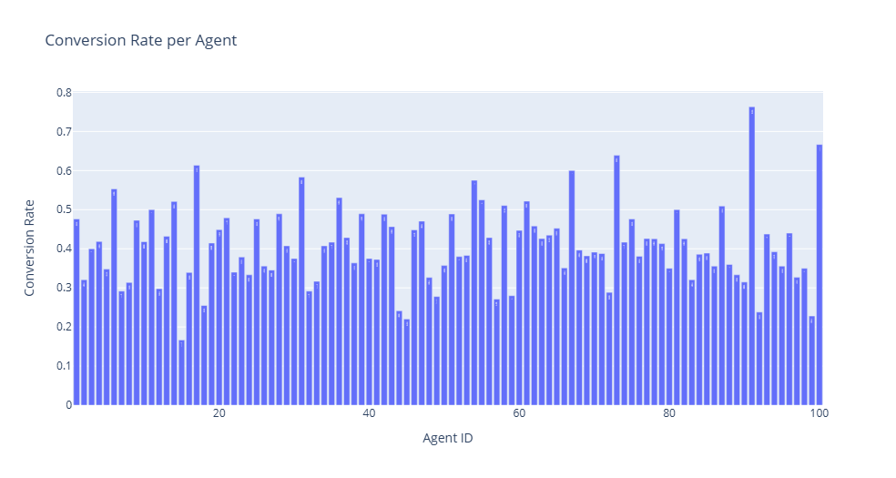
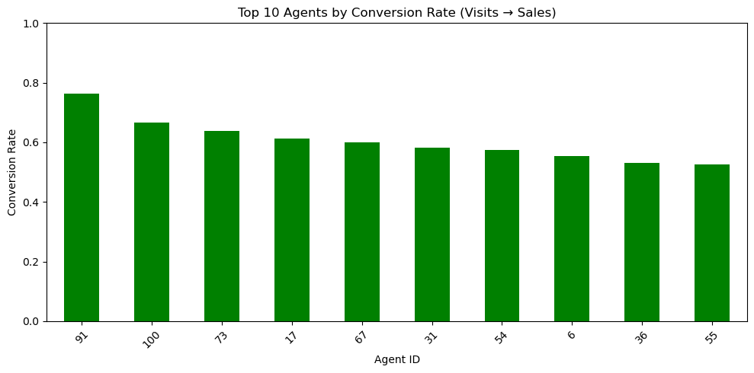
Top-Performing Agent
Agent ID : 91
Conversion rate : 76%

Slide 11
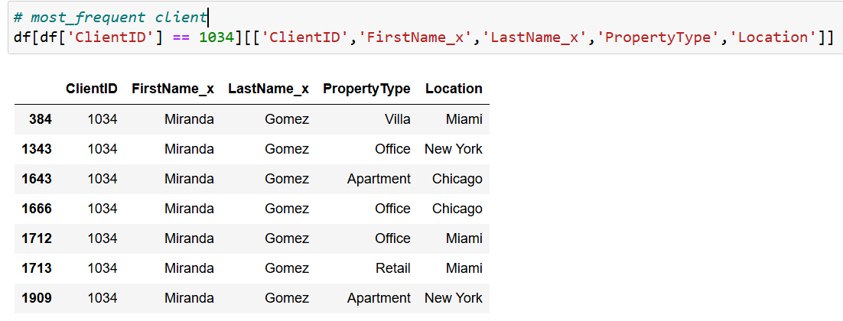
most frequent client

Slide 12

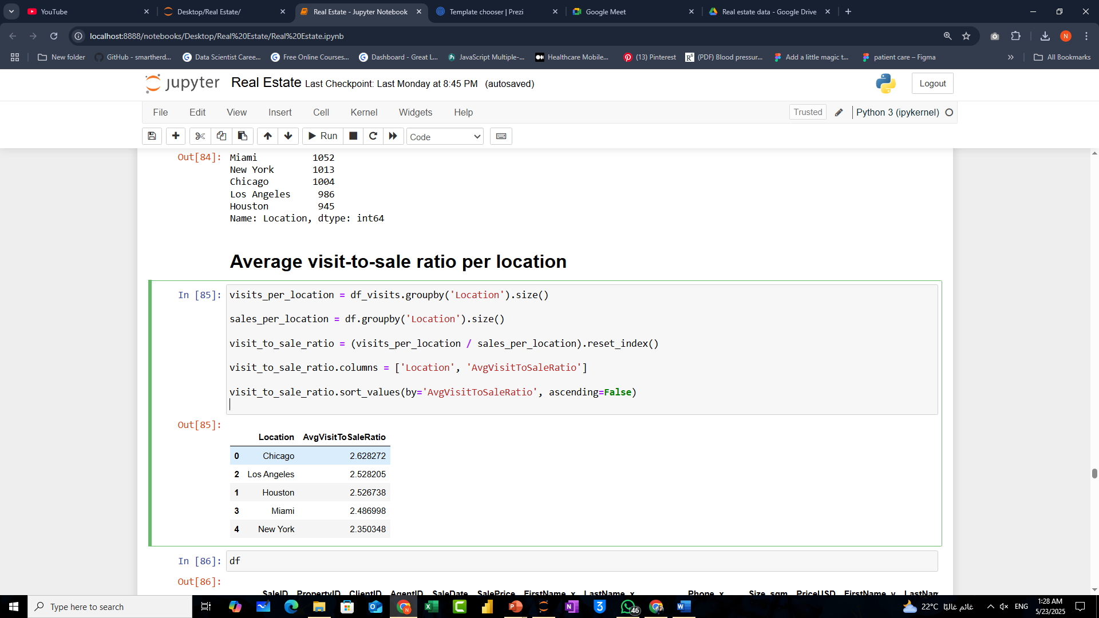
Average visit-to-sale ratio per location

Slide 13
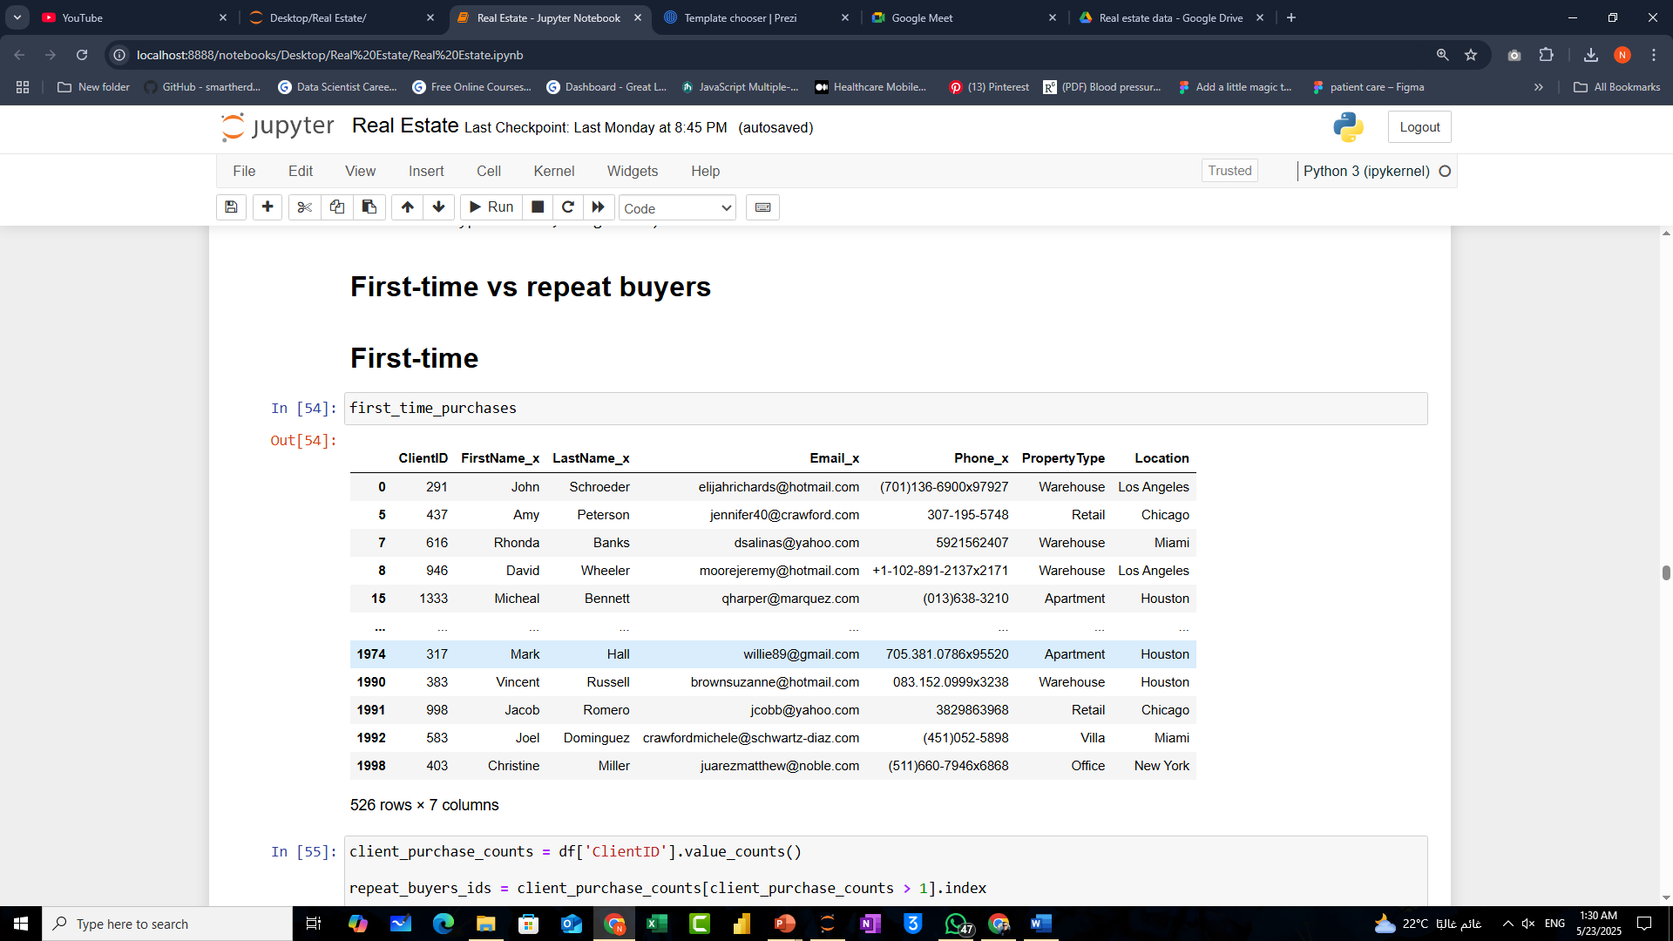
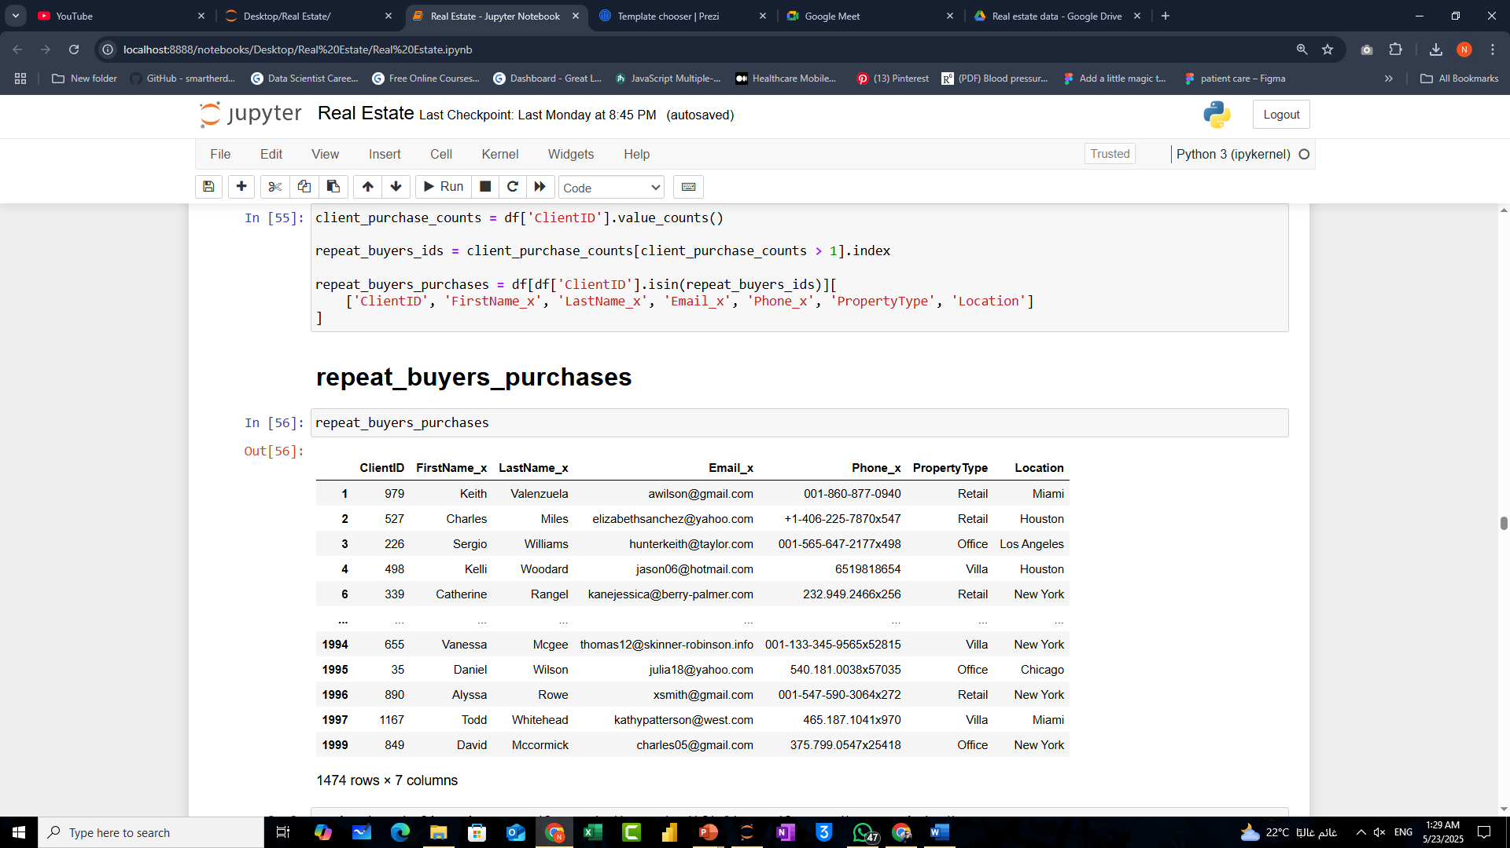

Slide 14
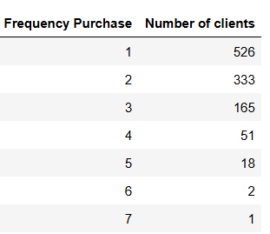
Customer Purchase Frequency Distribution

Slide 15
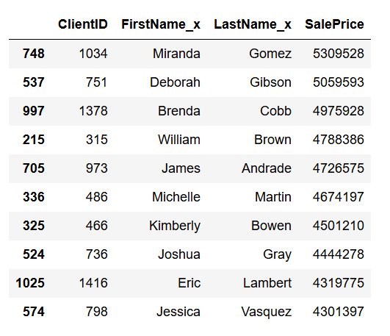
Top 10 spender clients

Slide 16
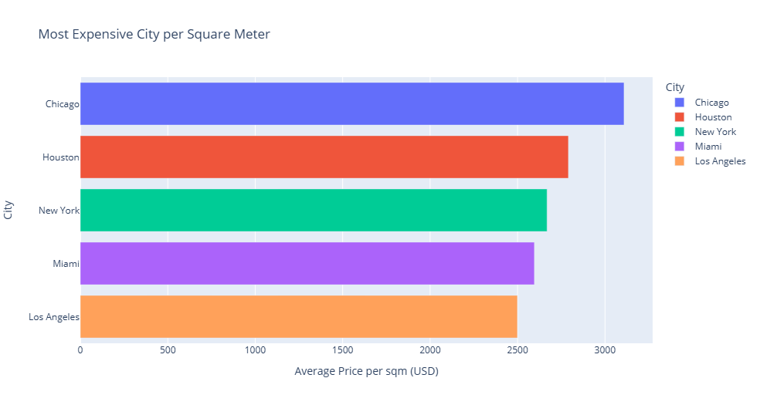

Slide 17
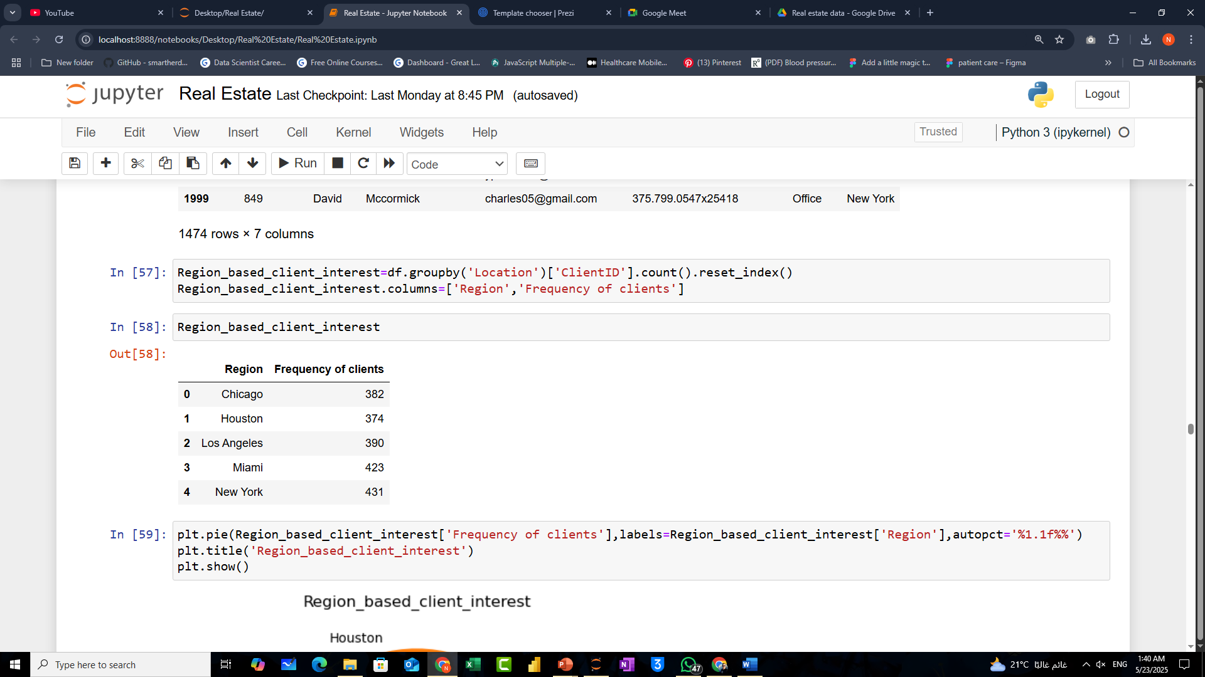
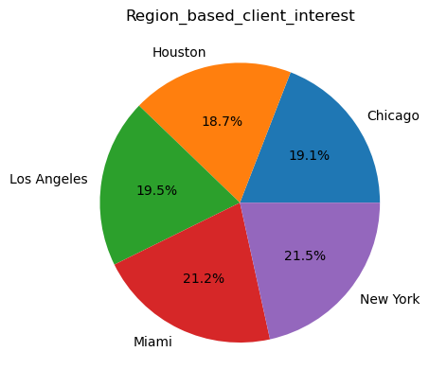

Slide 18
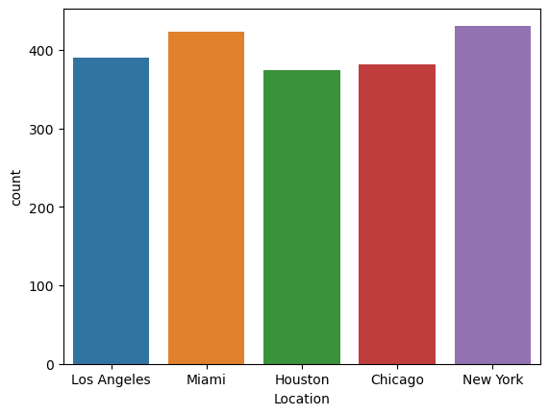
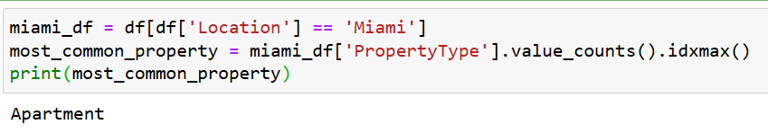
"The most sold property type in Miami is:"

Slide 19
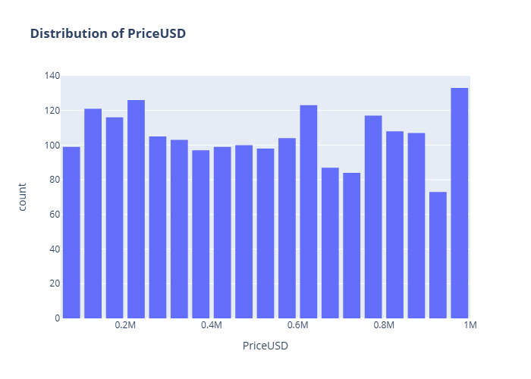
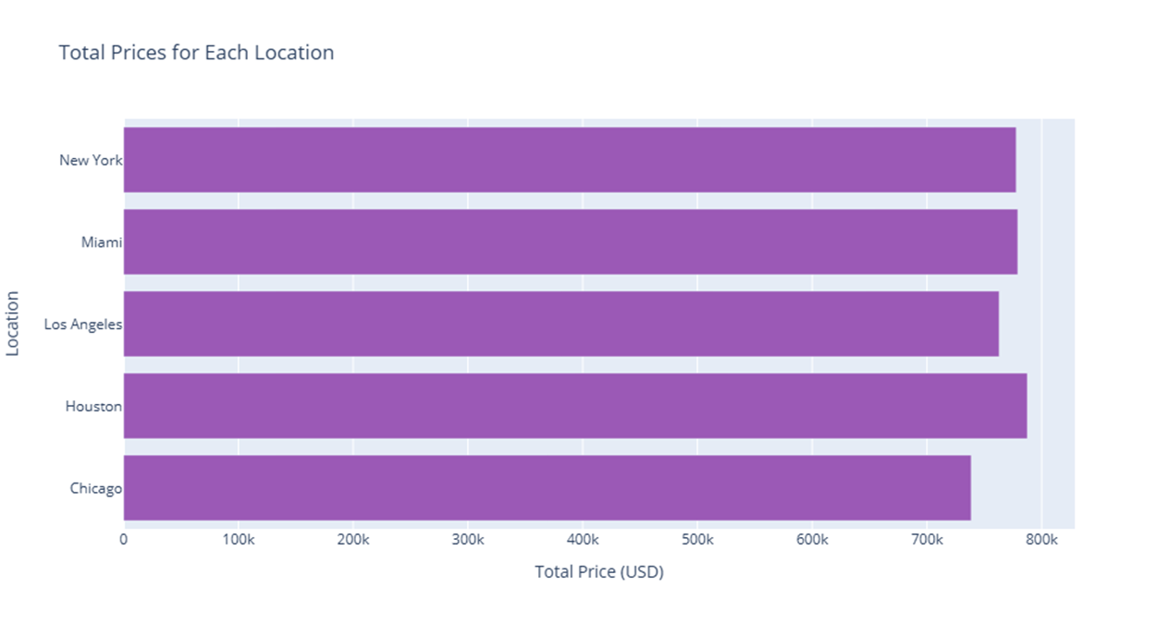

Slide 20


Slide 21


Slide 22
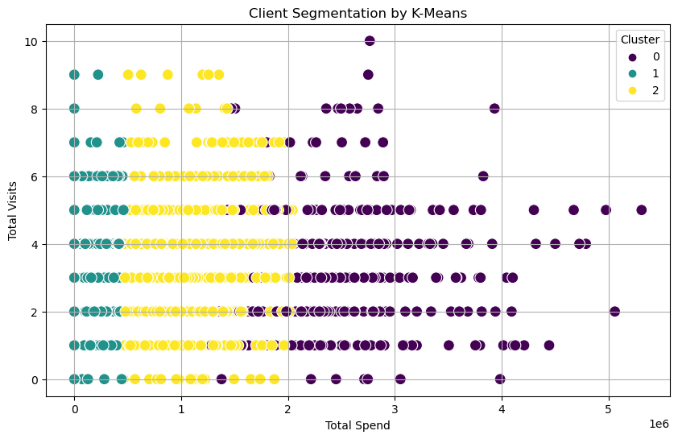
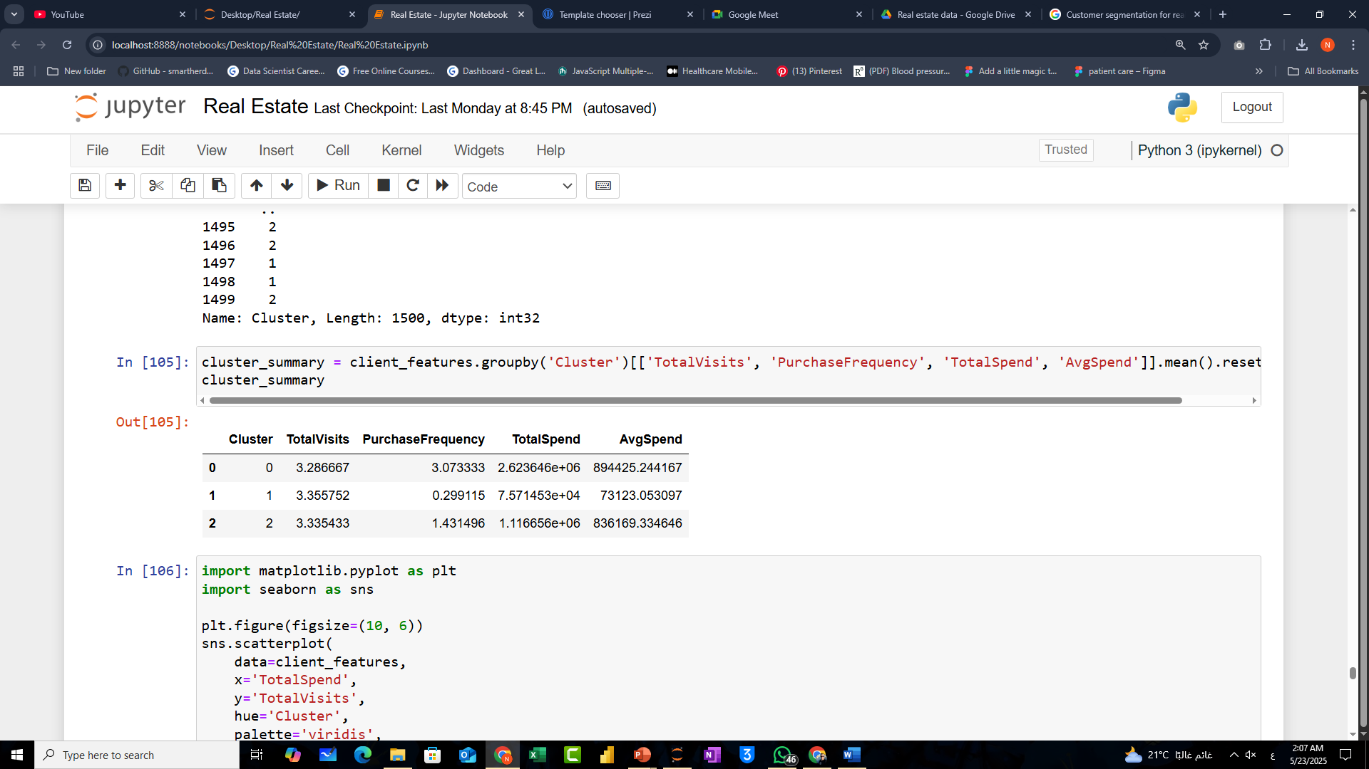
Using K-Means Cluster

Slide 23
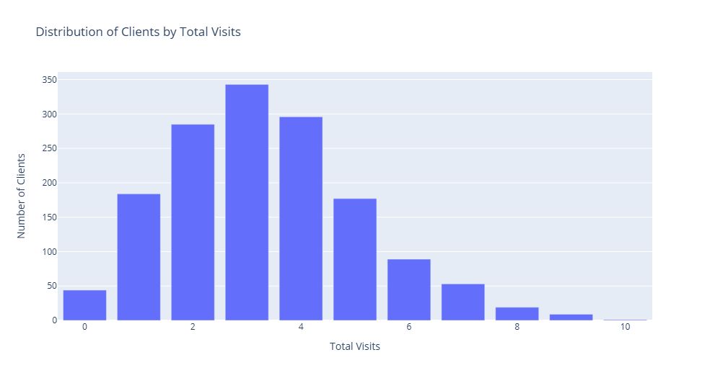

Slide 24
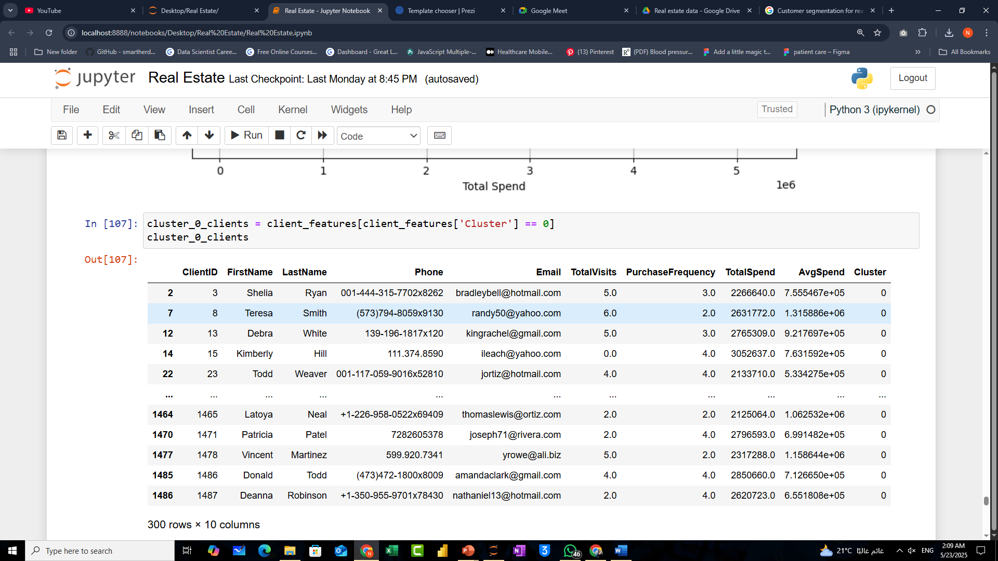


Slide 25
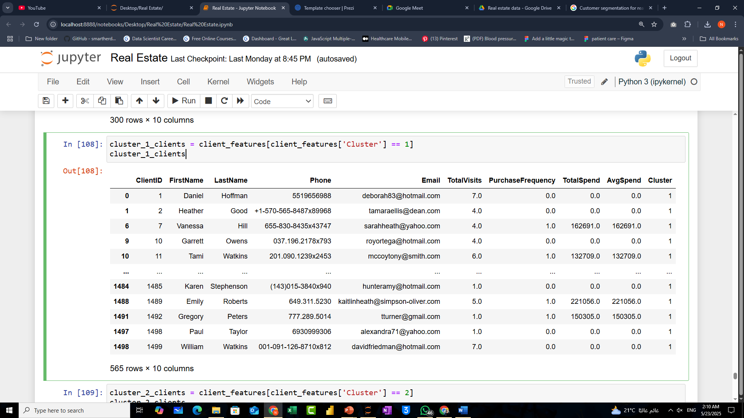

Slide 26
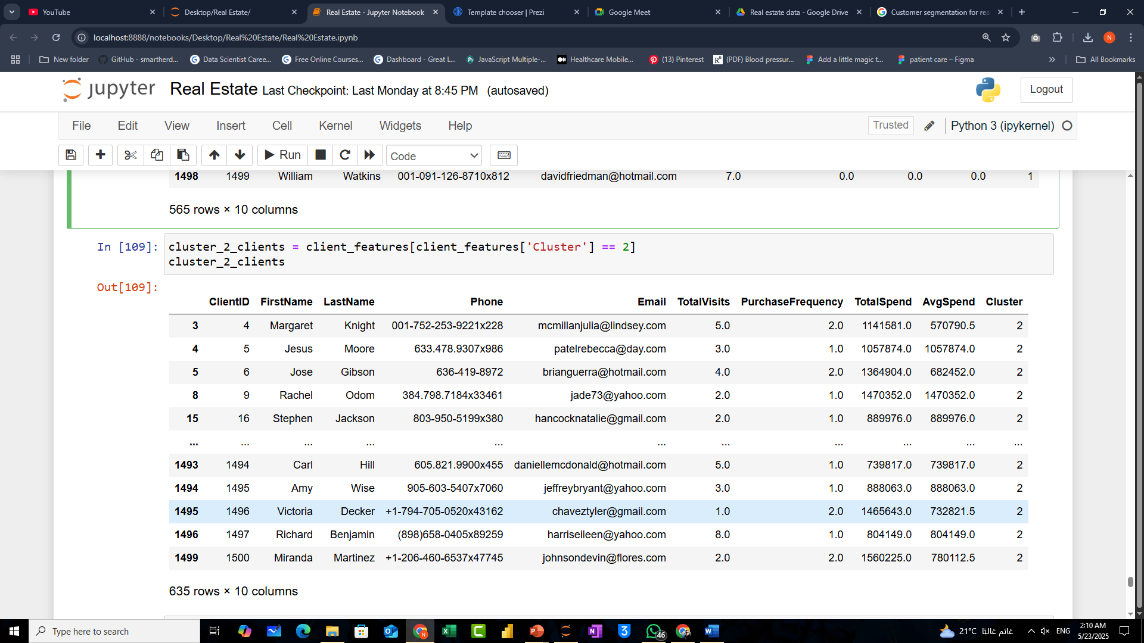

Slide 27
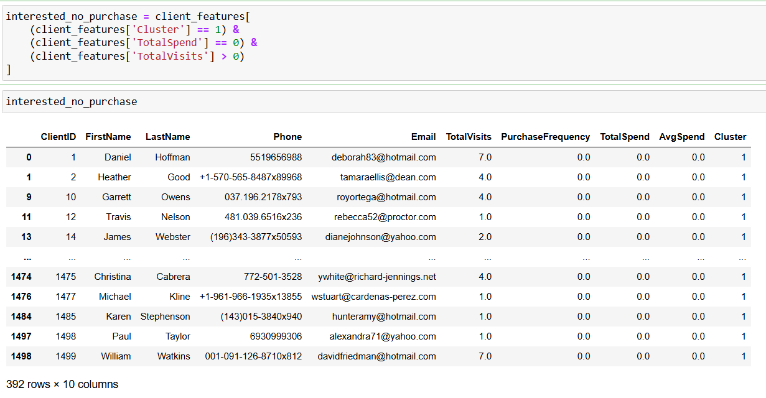

Slide 28
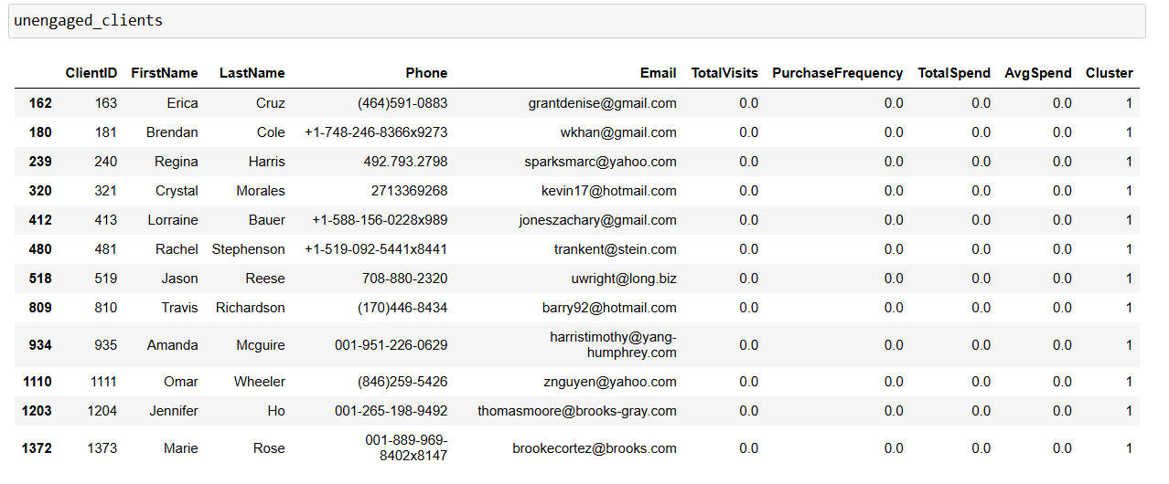

Slide 29

Power BI Dashboard

Slide 30








Conclusion
Built Robust Data Solution
Derived Actionable Insights
From Azure SQL to Power BI
That can drive real estate growth
Expand Analysis
Continuously Refine
Include customer satisfaction and agent performance metrics
Dashboards and analysis

Slide 31






Action Plan
Norhan Zaid
Safey El Deen Mohamed
Maged Fouad Mohamed
Ramy Elbouhy
Rawan Mohi
abdelghany ahmed

Slide 32

Q&A
?
!
Questions
Feedback
Invite questions from the audience
Welcome feedback on the presentation
✓
Discussion
Open floor for further discussion
Invite questions and feedback from the audience.

